Slide 1
BIGG BOSS REALITY SHOW
Group G
Chaitanya Pokuri
Hareendra Donapati
Nikhil Peddada
Yasaswani Gandi

Slide 2
Introduction
Bigg Boss is an Indian reality television show where contestants from different walks of life live together in a specially constructed house which is isolated from the outside world.
During their stay in the house, housemates were monitored by live television cameras and as well as personal audio microphones.

Slide 3
This program relies on techniques such as evictions, weekly tasks and competitions set by Big boss and the “Confession room” where housemates convey their private thoughts to the camera and reveal their nominees for eviction.
There will be a wild card entry into the house at any point of the time.
The winner of the season will be awarded with a prize money.

Slide 4
Dataset
Here is the Data dictionary for Big Boss (India) dataset
Language - Language in which the show is designed for and telecasted
(Hindi, Kannada, Malayalam, Marathi, Tamil, Telugu)
Season Number - Season number.
Name - Name of participant.
Industry – Professional field of house mate.
Gender - Gender of the Bigg Boss contestant, such as Male, Female, Transgender
Number of days existed – Specifies the total number of days existed in house.
Season Length - Number of days of season.
Number of weeks – Specifies the number of days they stayed in house.
% Stayed – Specifies the Percentage of season length they stayed.
Number of Housemates - Total number of house mates, in entire season, including wildcard entries.
Host Name - Name of the host (who hosted most of the weekend episodes).
Eviction Nominations Faced - Number of Nominations Faced by the Bigg Boss house mate to be Evicted
Average TRP - Average TV TRP of the season.
Number of re-entries - Number of re-entries into the house.
Number of times elected as Captain - Number of times elected as Captain.
Winner - Winner or not (1 - winner, 0 - otherwise).

Slide 5
Inference 1
Does No. Of Eviction Nominations affect Winning?
In our dataset, Winner is indicated by the value 1, if not 0, which makes it to be a Binary categorical variable.
As the dependent variable is categorical (values-0,1), we performed Binary Logistic regression, and the obtained p-value is less than α, using which we conclude No. of Eviction Nominations affect Winning.
But is it affecting Positively or Negatively?
H₀: No. of Eviction Nominations is not one of the factor for Winning H₁: No. of Eviction Nominations is one of the factor for Winning

Slide 6
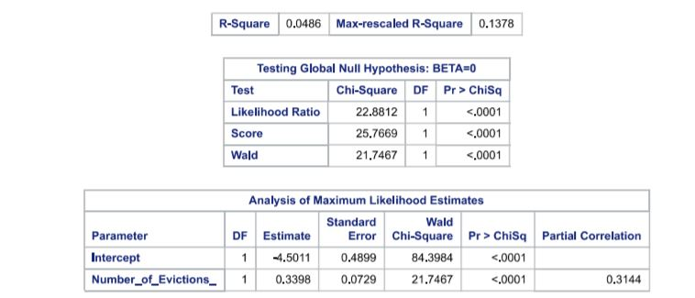

Slide 7
Inference 2
Does the Days Stayed(%) vary by Gender?
As the Gender has 3 categories (Male, Female & Transgender), we have performed ANOVA to check the variance. The results show that Percentage of Stay for contestant depends on their Gender.
H₀: Days Stayed(%) does not vary by Gender H₁: Days Stayed(%) varies by Gender

Slide 8
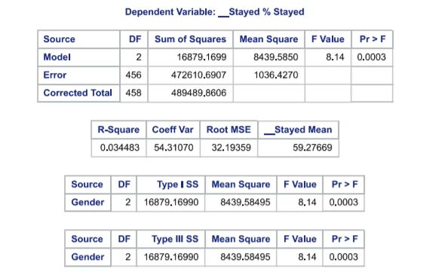
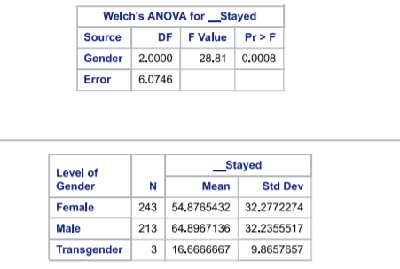

Slide 9
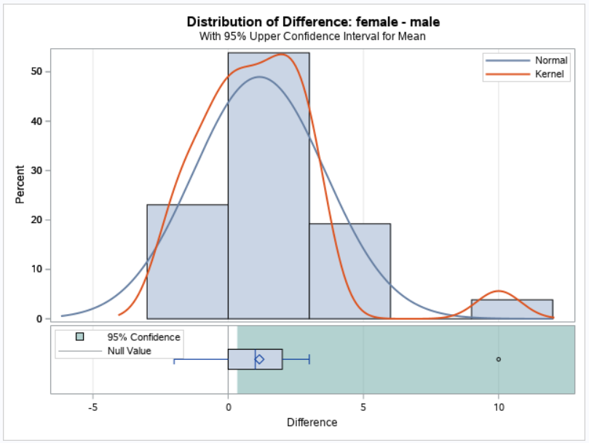
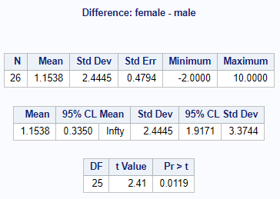
Inference 3
Which Gender contestants are selected more?
Paired t-Test for Female vs Male by season, (Transgender ignored as there are very few observations)

Slide 10
Inference 4
Is there any correlation between Season length and Number of Housemates?
For a given Language and Season, on what criteria Number of Housemates are fixated?
Or How a Season Length is fixed?
H₀: ρ = 0 H₁: ρ ≠ 0

Slide 11
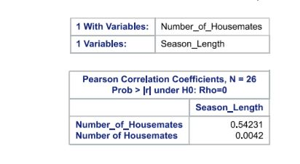

Slide 12
Inference 5
Are Gender and Profession of the contestants independent or not?
By performing Chi Square Test of Independence, it is determined that there is association in between Gender and Profession of contestants.
H₀: There is no association between Gender and Profession H₁: There is association between Gender and Profession

Slide 13
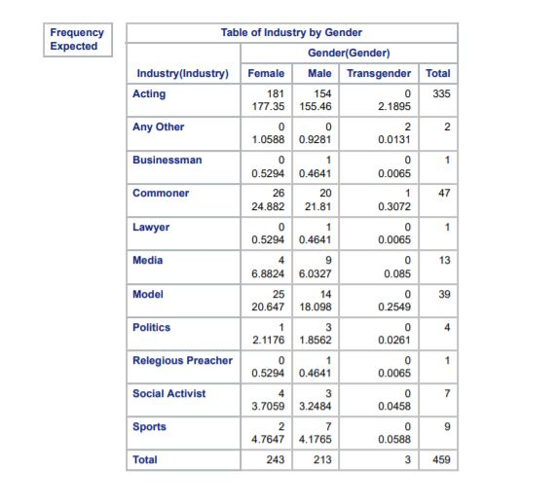
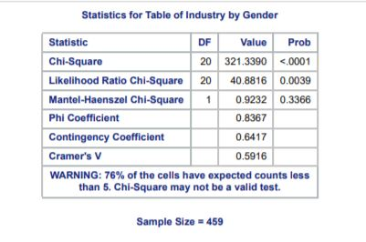

Slide 14
Inference 6
What are the factors that effect to stay longer?
We have used Multiple Linear Regression to find the evidence of dependency on No. of times as Captain, No. of Eviction Nominations, No. of Housemates for Percent Stayed, where the Model is proved to be significant.
H₀: Percent Stayed is independent of No. of times as captain, No. of Eviction Nominations, No. of Housemates H₁: Percent Stayed is dependent of No. of times as captain, No. of Eviction Nominations, No. of Housemates

Slide 15
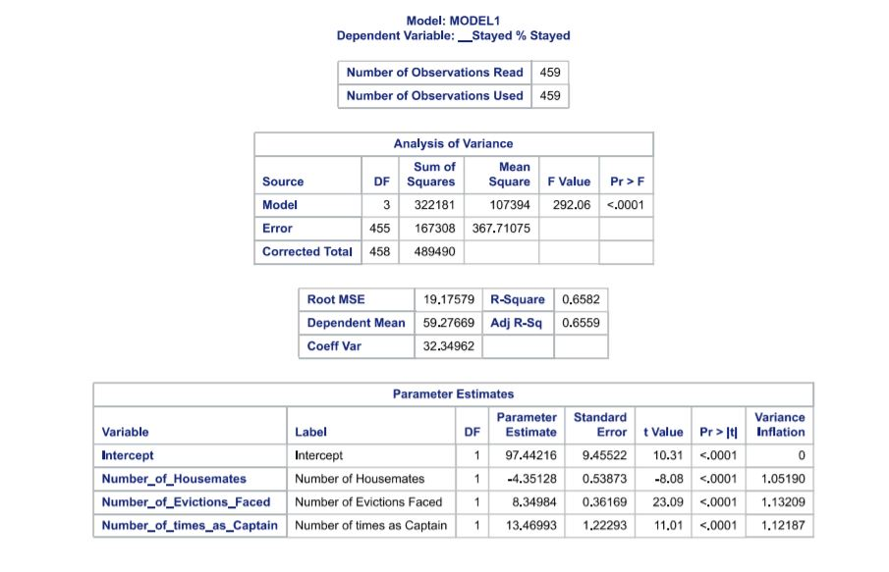

Slide 16
Inference 7
What are the factors prominent to be a captain?
We have used Multiple Linear Regression to find the evidence of dependency on
% of Stay, No. of Eviction Nominations, No. of Housemates for No. of times as Captain, where the Model is proved to be significant.
H₀: No. of times as Captain is independent of % of Stay, No. of Eviction Nominations, No. of Housemates H₁: No. of times as Captain is not independent of % of Stay, No. of Eviction Nominations, No. of Housemates

Slide 17
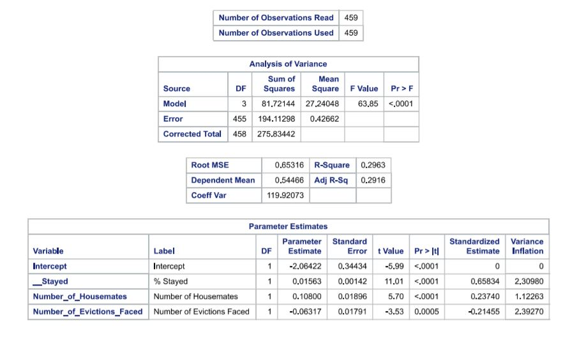

Slide 18
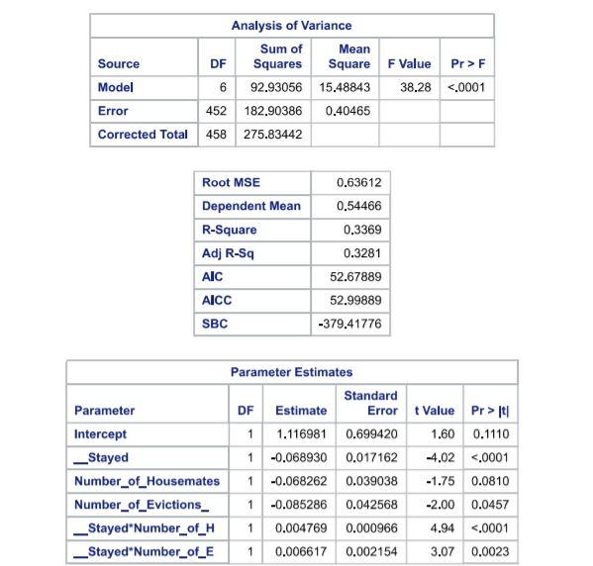

Slide 19
Thank You

